Slide 1






BCS202L- Data Structures and Algorithms
Dr. Priyanka N
Assistant Professor Senior Grade 1
School of Computer Science & Engineering VIT, Vellore.

Slide 2





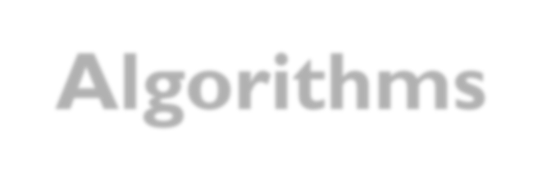


BCS202L- Data Structures and Algorithms
Module-1: Algorithm Analysis
Module-2: Linear Data Structures
Module-3: Searching and Sorting
Module-4:Trees
Module-5: Graphs
Module-6: Hashing
Module-7: Heaps and AVL Trees

Slide 3

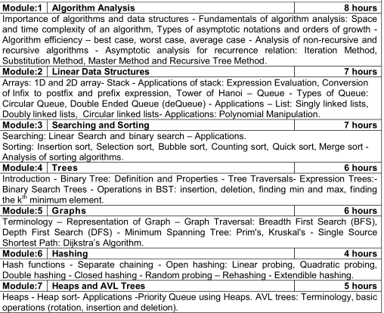

Slide 4
BCS202L- Data Structures and Algorithms
Text Books:
1. Mark A. Weiss, Data Structures & Algorithm Analysis in C++, 4 th
Edition, 2013,Pearson Education.
Reference Books:
Alfred V. Aho, Jeffrey D. Ullman and John E. Hopcroft, Data
Structures and Algorithms,1983, Pearson Education.
Horowitz, Sahni and S. Anderson-Freed, Fundamentals of Data Structures in C, 2008, 2nd Edition, Universities Press.
Thomas H. Cormen, C.E. Leiserson, R L. Rivest and C. Stein,
Introduction to Algorithms, 2009, 3rd Edition, MIT Press.

Slide 5

Module 6: Hashing
Hash functions
Open Hashing( Closed Addressing)
🞄 Separate Chaining
Closed Hashing(Open Addressing)
🞄 Linear Probing
🞄 Quadratic Probing
🞄 Double Hashing
Random Probing
Rehashing
Extendible Hashing

Slide 6


Hashing
Implementation of hash table is called Hashing
Hashing is a technique used for performing insertions, deletions, and find in constant average time

Slide 7




Goals of Hash- ADT
Structure will be a table (relatively small)
Table completely contained in memory
Implemented by an array
Capitalizes on ability to access any element of the array in constant time

Slide 8


Hashing- General Idea
Hash table data structure is an array of some fixed size containing the items( Keys and associated values)
For Example: Generally Search is performed on data members with respect to the item. This is called the key.

Slide 9


HASH Table
Table Size :
0 to Tablesize-1
Keys | Associated Values
0
1
2
3 | Jack
4 | Priya
5
6 | Dinesh
7 | Martin
8
9 | Suban
Each key is mapped into some number in the range 0 to TableSize − 1 and placed in the appropriate cell.- Hash Function

Slide 10

Problems in Hash Table ADT
Choosing a function
Deciding the Hash Table Size
Deciding what to do when two keys hash to the same value( Also called as Collision)

Slide 11

Hash Functions
A hash function is a key to address transformation
Determines position of key in the array
For Example: If the input keys are integers, then simply returning Key mod TableSize is generally a reasonable strategy
Key % Table size

Slide 12

Hash Functions
Let us consider f(x) = x % 15. Then,
x = | 25 | 129 | 35 | 26 | 47 36
f(x) = | 10 | 9 | 5 | 11 | 2 6
Storing the keys in the array is straightforward:
0 | 1 | 2 | 3 | 4 | 5 | 6 | 7 | 8 | 9 | 10 | 11 | 12 | 13 | 14
 |  | 47 |  |  | 35 | 36 |  |  | 129 | 25 | 26
Thus, Delete and FIND can be done in O(1), and also insert,
But Except???????????

Slide 13

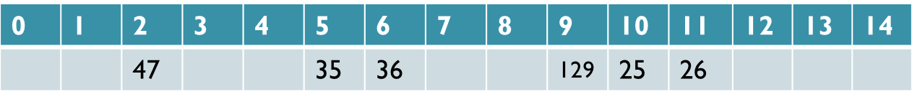
Hash Functions
What happens when you try to insert: x = 65 ?
x =
65
5
f(x) =
65
This is called a collision.

Slide 14


Handling Collisions
When an element is inserted, it hashes to the same value as an already inserted element, then we have a collision and need to resolve it.
Types of Hashing
Open Hashing( Closed Addressing)
🞄 Separate Chaining
Closed Hashing(Open Addressing)
🞄 Linear Probing
🞄 Quadratic Probing
🞄 Double Hashing

Slide 15
Open Hashing - Separate Chaining
Let us consider where the following elements stored in 16,14, 29,99,129
Let us consider f(x) = x % 15. Then,
X | 14 | 16 | 29 | 99 | 129
f(x) | 14 | 1 | 14 | 9 | 9
0 | 1 | 2 | 3 | 4 | 5 | 6 | 7 | 8 | 9 | 10 | 11 | 12 | 13 | 14
 | 16 | 47 |  |  | 35 | 36 | 127 |  | 99 | 25 | 26 |  |  | 14
Create linked list
129
29
New keys go at the front of the respective chain.

Slide 16

Separate Chaining: Disadvantages
Parts of the array may never be used.
As chains get longer, search time increases to O(n) in the worst case.
Constructing new chain nodes is relatively expensive (still constant time, but the constant is high).
Is there a way to use the “unused” space in the array instead of using chains to make more space?

Slide 17

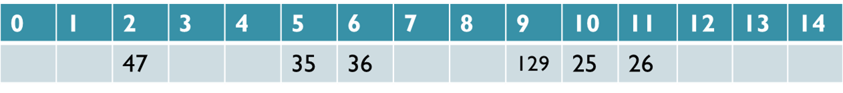
Closed Hashing(Open Addressing)
Linear Probing
Let Key x be stored in element f(x)=t of the array
65
??
If the hash table is not full – Attempt to
store in the next
array element
Example: (t+1)%N, (t+2)%N, (t+3)%N ……. Untill finding an empty slot

Slide 18
Linear Probing
For Example: Where do you store 65?
65%15=5
65
1
2
3
Number of Probes: 3
For Example :Where do you store 16 ?
16%15=1
16
65
Number of
Probes: 1
1

Slide 19

Linear Probing
For Example: Where do you store 29 ?
29%15=14
16
65
29
Number of Probes: 1
For Example: Where do you store 14 ? 14%15=14
1
14 16
65
29
2
Number of Probes: 2
1

Slide 20


Linear Probing
For Example :Where do you store 99 ?
99%15=9
16
65
99
29
Number of
Probes: 4
1
2
3
4
For Example :Where do you store 127 ?
127%15=7
16
65
127
99
29
Number of Probes: 2
1
2

Slide 21
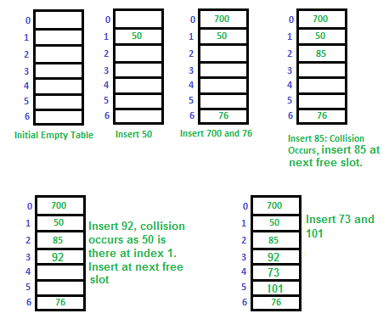
Example: Let us consider a simple hash function as “key mod 7” and a sequence of keys as 50, 700, 76, 85, 92, 73, 101, which means hash(key)=key%S, here S=size of the table =7,indexed from 0 to 6.
700%7=0
76%7=6
50%7=1
85%7=1
Collision
73%7=3
101%7=3
92%7=1
Collision

Slide 22

Linear Probing
Eliminates need for separate data structures (chains), and the cost of constructing nodes.
Leads to problem of clustering. Elements tend to cluster in dense intervals in the array.
••••••• --- ••••••----•••••••••••--•••••••-•
Search efficiency problem remains.
Deletion becomes trickier

Slide 23

Closed Hashing(Open Addressing)
Quadratic Probing
Let Key x be stored in element f(x)=t of the array
65
??
What to do??
If the hash table is not full – Attempt to store in the next array element( For Example: (t+1²)%N, (t+2²)%N, (t+3²)%N
……. Untill finding an empty slot

Slide 24

Quadratic Probing
For Example :Where do you store 65?
65%15=5 (t=5)
65
Attempt1 Attempt2 t t+1²
Attempt3 t+ 2²
Attempt4 t+ 3²
(t+1²)%N
(5+1)%15=6
(t+2²)%N
(5+4)%15=9
(t+3²)%N
(5+9)%15=14
1
2
3
4
Number of Probes: 4

Slide 25

For Example :Where do you store 99? 99%15=9
16
65
99
29
In the case of above scenario in linear
probing
Number of Probes: 4
Quadratic Probing
16
65
99
29
Attempt1 t
Attempt2 t+1
Attempt3 t+4
Number of Probes: 3
(t+1²)%N
(9+1)%15=10
(t+2²)%N
(9+4)%15=13

Slide 26
Quadratic Probing
Tends to distribute keys better than linear probing
Resolves the problem of clustering
Runs the risk of an infinite loop on insertion, unless precautions are taken.
– For Example: Consider inserting the key 16 into a table of size 16, with positions 0, 1, 4 and 9 already occupied.

Slide 27
Closed Hashing(Open Addressing)
Double Hashing
Let Key x be stored in element f(x)=t of the array
65
??
What to do??
Define a second hash function f₂(x)=d. Attempt to store key in next array elements (t+1d)%N, (t+2d)%N, (t+3d)%N …until you find an empty slot.
Formula-> (H(key) + i * H₂(key)) mod N
N->Table_size
i-> 0 to Table_size-1

Slide 28


Double Hashing
The popular second hash function:
f₂(x)=R − (x % R)
where R is a prime number, R<N

Slide 29

Double Hashing
For Example :Where do you store 65 ?
Probe 1 (t)
As we from know Hash Function 1: f(x) = x % N
f(65)=65%15=5 (t=5), Collision Occurred
Apply Second Hash Function
f₂(x)= 11 − (x % 11)
Consider R= 11(Prime number <Table_size)

Slide 30

Double Hashing
For Example :Where do you store 65 ?
65
1
2
3
No of Probes:3
t
t+1
t+2
Attempt to store key in next array elements (t+1d)%N, (t+2d)%N, (t+3d)%N …
Probe 1->f(65)=(65%15)=t=5 [Collision Occurred]
In case of collision apply Second Hash Function
f₂(x)= 11-(x %11)
f₂(65)=(11-(65%11))= d=1
Probe 2->(t+1d)%N=(5+1*1)%15 =6
Probe 3->(t+2d)%N =(5+2*1)%15 =7

